Slide 1

Basic CRUD operations, Functions, Expressions and Clauses

Slide 2
Agenda
DDL,
DML,
Query and Operations,
Clauses,
Aggregate Functions,
String Functions,
GROUP BY,
Having,
Rank Functions

Slide 3
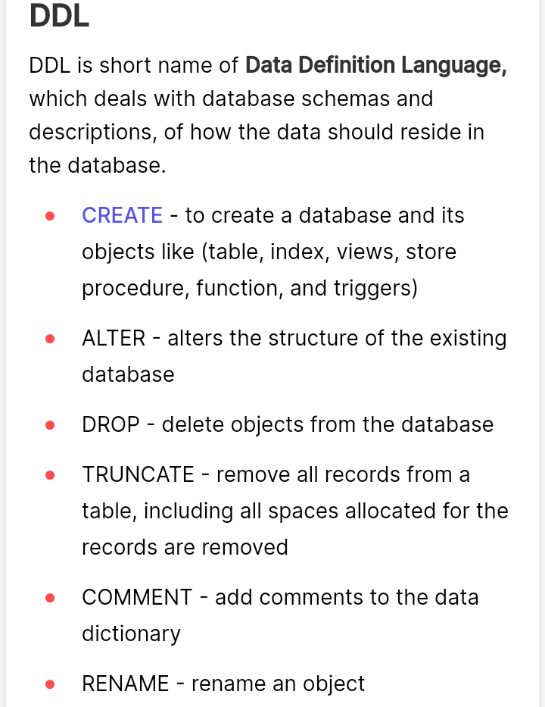
DDL

Slide 4
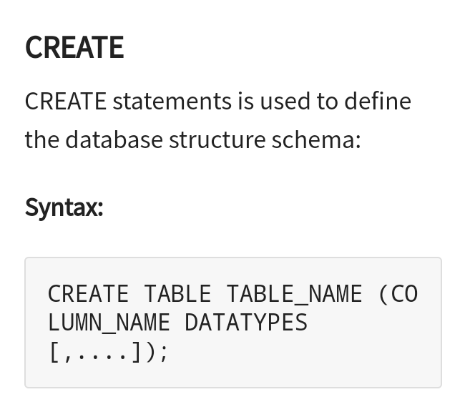

Slide 5
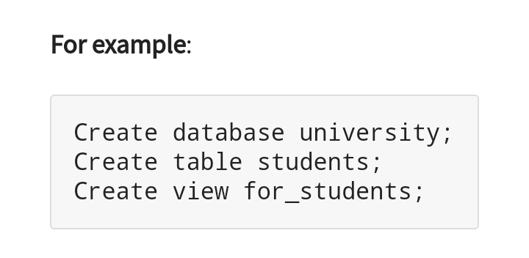

Slide 6
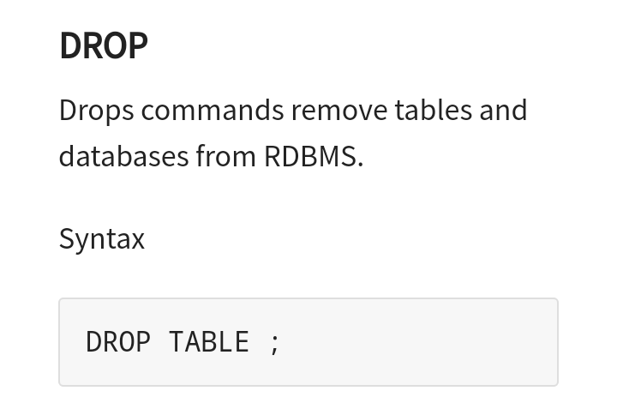

Slide 7
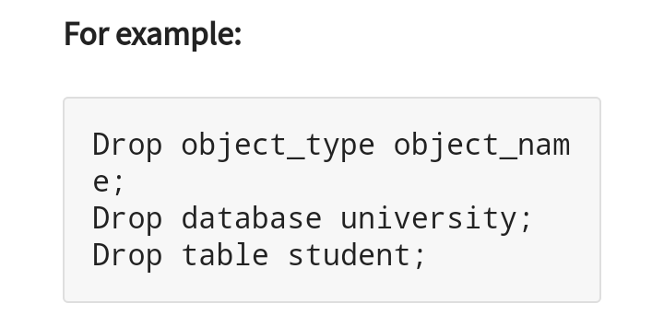

Slide 8
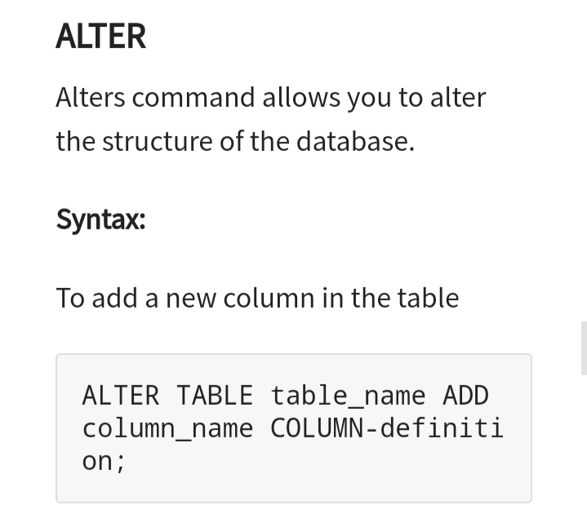

Slide 9
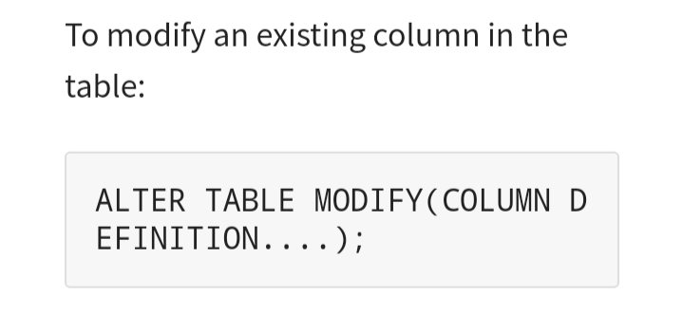

Slide 10
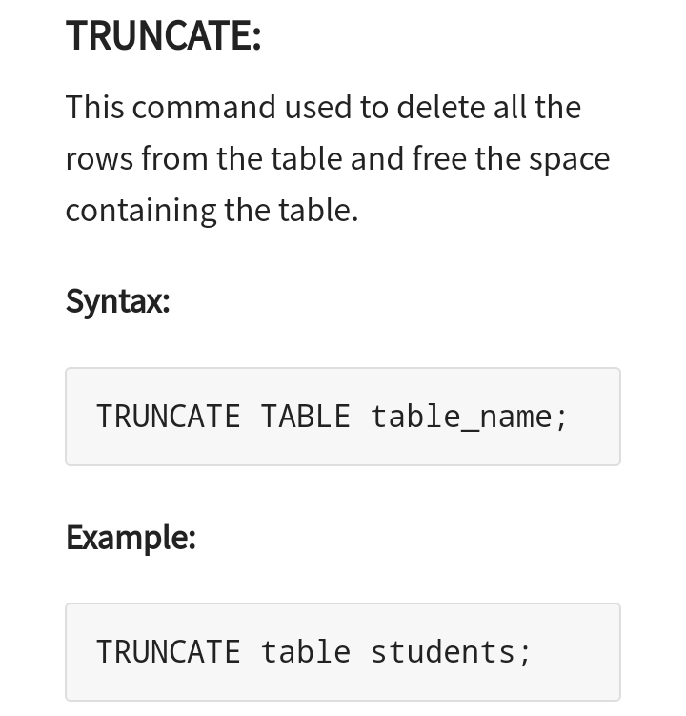

Slide 11
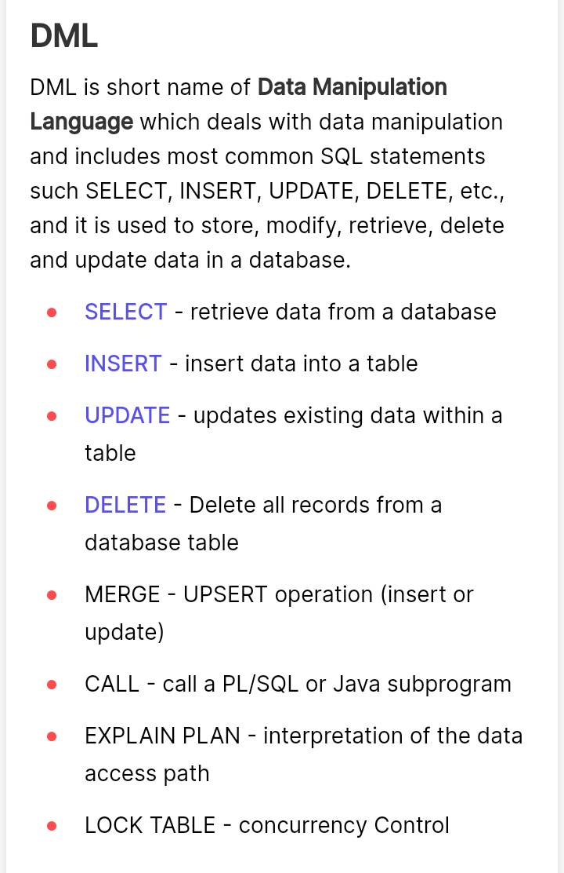

Slide 12
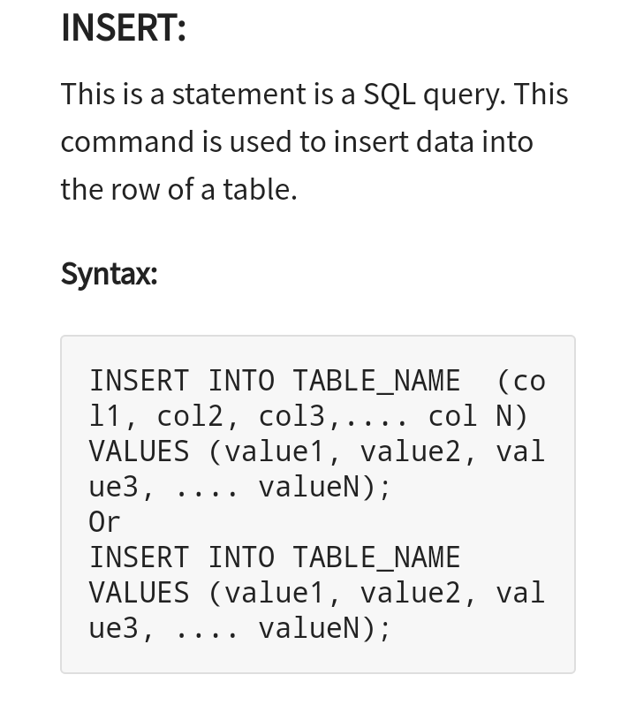

Slide 13
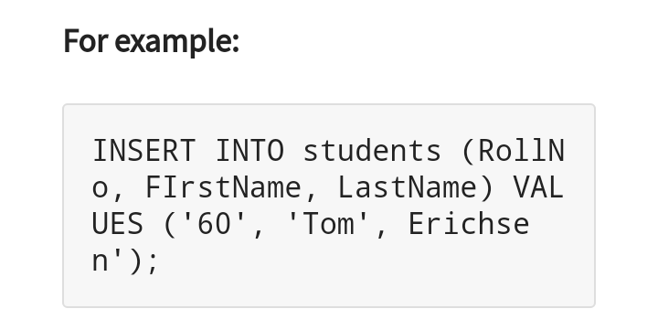

Slide 14
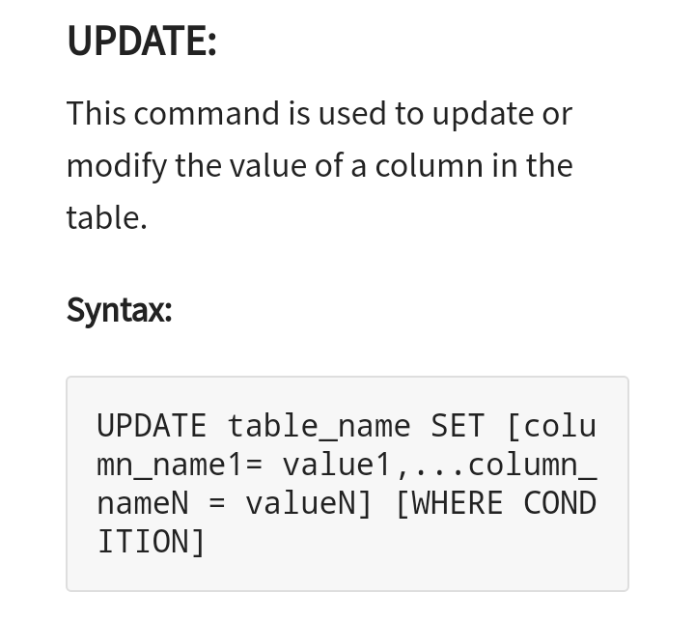

Slide 15
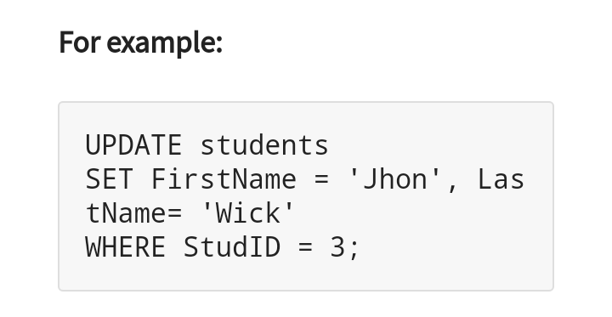

Slide 16
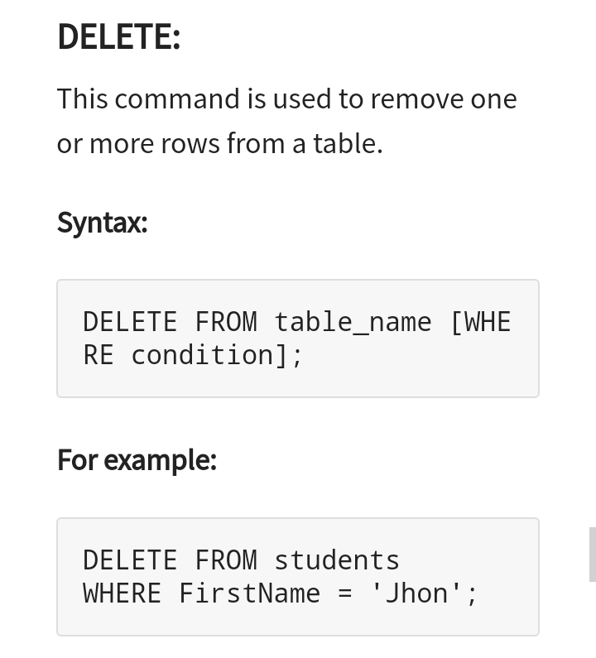

Slide 17
Queries in MySQL
In relational database management systems, a query is any command used to retrieve data from a table.
In Structured Query Language (SQL), queries are almost always made using the SELECT statement.
A list of commonly used MySQL queries to create database, use database, create table, insert record, update record, delete record, select record, truncate table

Slide 18
Clauses
WHERE Clause in MySQL is a keyword used to specify the exact criteria of data or rows that will be affected by the specified SQL statement.
The WHERE clause can be used with SQL statements like INSERT, UPDATE, SELECT, and DELETE to filter records and perform various operations on the data.

Slide 19
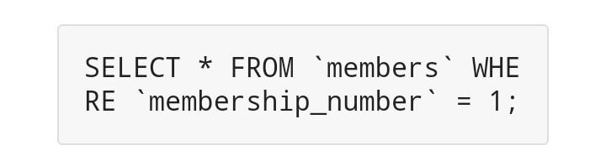
WHERE clause Syntax
SELECT * FROM tableName WHERE condition;
"SELECT * FROM tableName" is the standard SELECT statement
"WHERE" is the keyword that restricts our select query result set and "condition" is the filter to be applied on the results. The filter could be a range, single value or sub query.

Slide 20
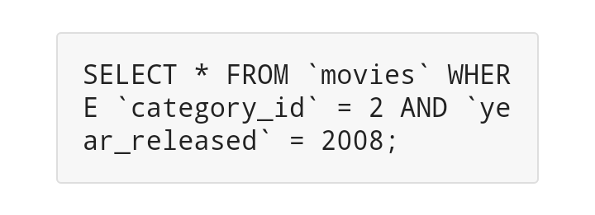
WHERE clause combined with - AND LOGICAL Operator
The WHERE condition in MySQL when used together with the AND logical operator, is only executed if ALL filter criteria specified are met.

Slide 21
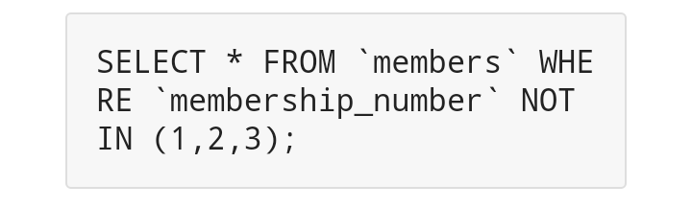
WHERE clause combined with - IN Keyword
The WHERE clause when used together with the NOT IN keyword DOES NOT affects the rows whose values matches the list of values provided in the NOT IN keyword.
The following query gives rows where membership_number is NOT 1 , 2 or 3

Slide 22
Aggregate Functions
MySQL's aggregate function is used to perform calculations on multiple values and return the result in a single value like the average of all values, the sum of all values, and maximum & minimum value among certain groups of values.
We mostly use the aggregate functions with SELECT statements in the data query languages.

Slide 23
Syntax
function_name (DISTINCT | ALL expression)
First, we need to specify the name of the aggregate function.
Second, we use the DISTINCT modifier when we want to calculate the result based on distinct values or ALL modifiers when we calculate all values, including duplicates. The default is ALL.
Third, we need to specify the expression that involves columns and arithmetic operators.

Slide 24
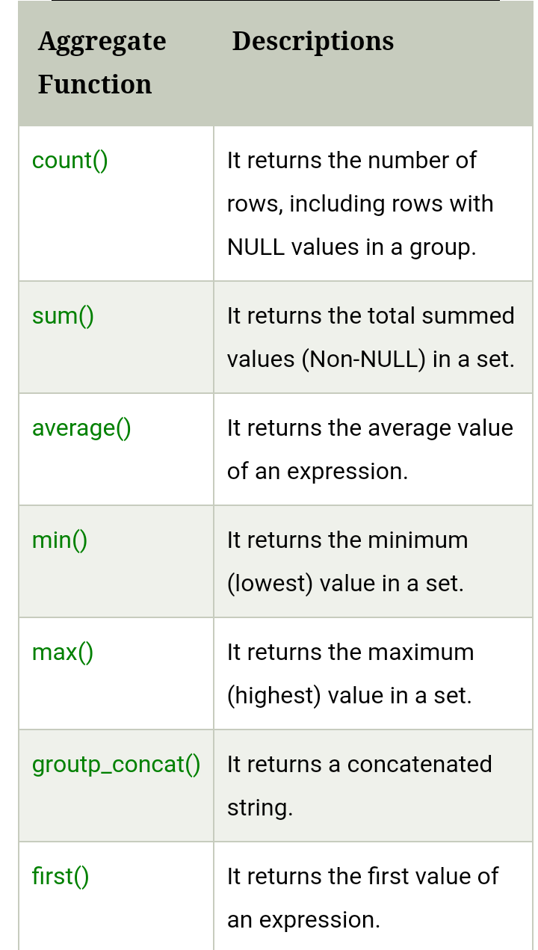

Slide 25
String Functions
SQL Server has many built-in functions.
This reference contains string, numeric, date, conversion, and some advanced functions in SQL Server.

Slide 26
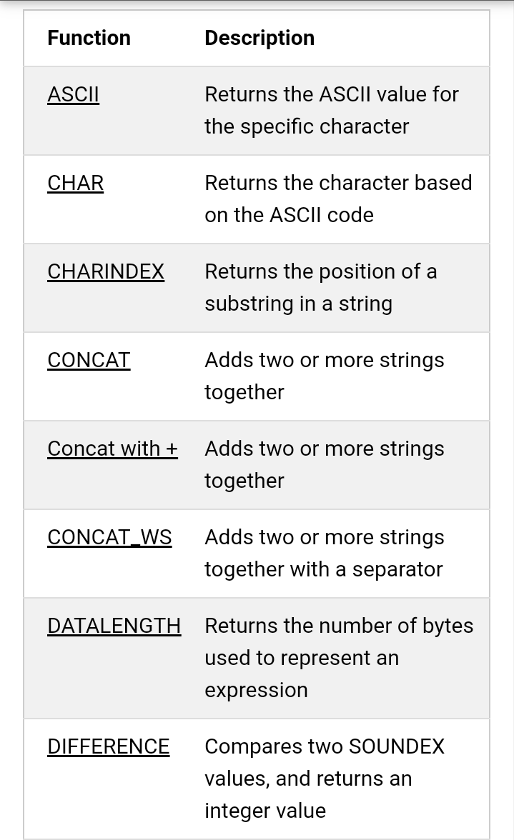

Slide 27
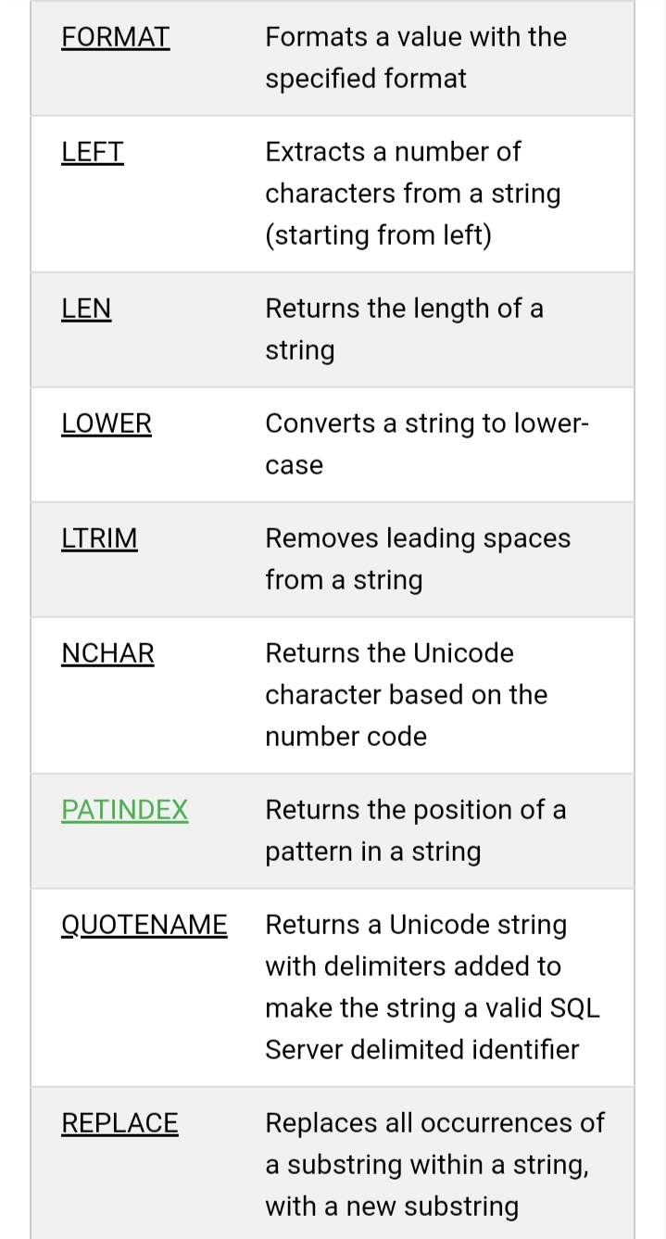

Slide 28
Group By
The MYSQL GROUP BY Clause is used to collect data from multiple records and group the result by one or more column. It is generally used in a SELECT statement.
You can also use some aggregate functions like COUNT, SUM, MIN, MAX, AVG etc. on the grouped column.

Slide 29
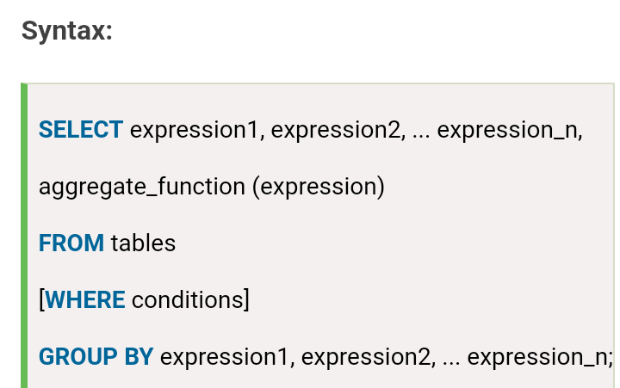

Slide 30
expression1, expression2, ... expression_n: It specifies the expressions that are not encapsulated within an aggregate function and must be included in the GROUP BY clause.
aggregate_function: It specifies a function such as SUM, COUNT, MIN, MAX, or AVG etc. tables: It specifies the tables, from where you want to retrieve the records.
There must be at least one table listed in the FROM clause.

Slide 31
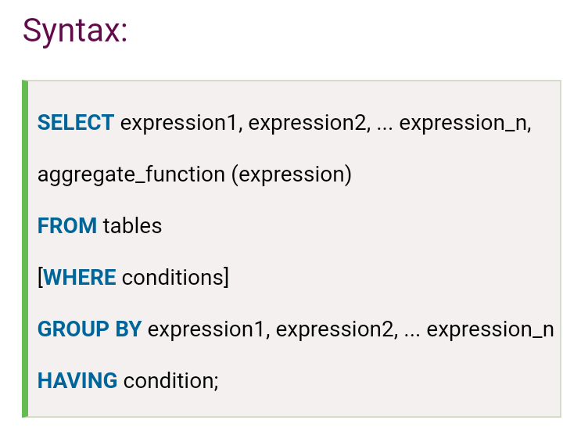
Having
MySQL HAVING Clause is used with GROUP BY clause. It always returns the rows where condition is TRUE.

Slide 32
aggregate_function: It specifies any one of the aggregate function such as SUM, COUNT, MIN, MAX, or AVG.
expression1, expression2, ... expression_n: It specifies the expressions that are not encapsulated within an aggregate function and must be included in the GROUP BY clause.
WHERE conditions: It is optional. It specifies the conditions for the records to be selected
HAVING condition: It is used to restrict the groups of returned rows. It shows only those groups in result set whose conditions are

Slide 33
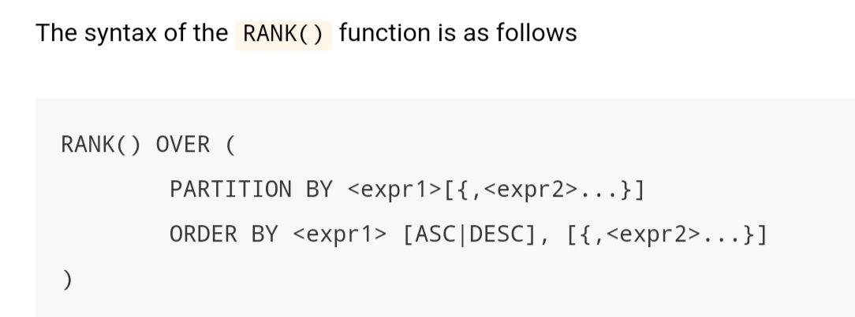
Rank Functions
The RANK() function is a window function that assigns a rank to each row in the partition of a result set.
The rank of a row is determined by one plus the number of ranks that come before it

Slide 34
First, the PARTITION BY clause distributes the rows in the result set into partitions by one or more criteria.
Second, the ORDER BY clause sorts the rows in each a partition.
The RANK() function is operated on the rows of each partition and re-initialized when crossing each partition boundary.

Slide 35


